Slide 2
Do we really need to change?
How do we go about changing?
What can we actually do now?

Slide 6
Don’t cut the number of charges to the number of ministers

Slide 7
Don’t cut the number of charges to the number of ministers
Every charge is anxious to have their own minister

Slide 8
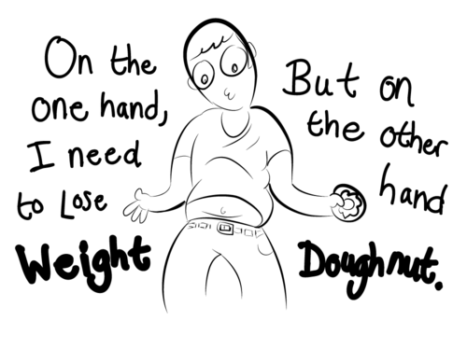

Slide 9
We should aim to have a minister of Word and Sacrament in every charge

Slide 10
Minister of Word & Sacrament
≠
Stipendiary Ministry

Slide 11
He handed out gifts of apostle, prophet, evangelist, and pastor-teacher to train Christ’s followers in skilled servant work, working within Christ’s body, the church, until we’re all moving rhythmically and easily with each other, efficient and graceful in response to God’s Son, fully mature adults, fully developed within and without, fully alive like Christ.
Ephesians 4 v’s 12 & 13
The Message, Eugene Peterson

Slide 12
Minister of Word & Sacrament
≠
Parish Ministry
Should fully include OLM

Slide 13
Minister of Word & Sacrament
≠
Parish Ministry
Should fully include OLM
Add:
Commissioned Local Ministers?

Slide 14
to consider the shape of new local church leadership roles which might be developed to sustain and build the Church in the future.

Slide 15
Enabling Sacramental Ministries

Slide 16
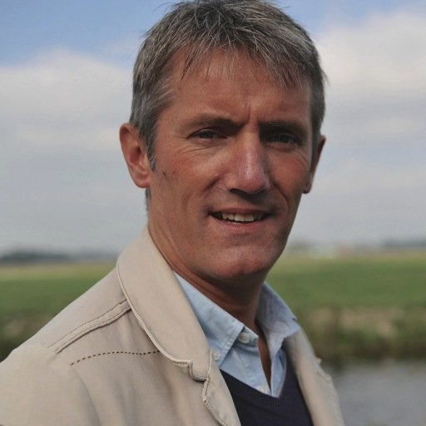
Church in a secular Age
&
Pioneer Ministry
March 2017
Glasgow
Videos available on the Church of Scotland website
Professor Stefan Paas
J.H. Bavinck Chair for Missiology and Intercultural Theology VU University Amsterdam.

